Slide 1
ARTIFICIAL INTELLIGENCE & MACHINE LEARNING
Probability & Statistics: Distributions, expectation, variance, covariance,
Session – 16

Slide 2




AIM OF THE SESSION
To familiarize students with the basic concepts of Probability & Statistics
INSTRUCTIONAL OBJECTIVES
This Session is designed to:
Explain Expectation, Variance, and Co-Variance.
Describe different types of Discrete and Continuous distributions.
LEARNING OUTCOMES
At the end of this session, you should be able to:
Define the concepts of Expectation, Variance, and covariance.
Understand different Distributions & Bayes theorem.

Slide 3
SESSION INTRODUCTION
A probability distribution describes how the values of a random variable are distributed. They are central to understanding randomness, risk, and data variability in fields like statistics, data science, finance, and engineering.
Two main types:
Discrete Distributions
Continuous Distributions

Slide 4
Why This Important?
Choosing the right distribution is key to accurate modeling, predictions, and decision-making.
Misidentifying the distribution (e.g., treating a continuous variable as discrete or vice versa) leads to incorrect analyses and conclusions.
Discrete and continuous distributions have different formulas and properties—knowing which to use ensures statistical rigor and meaningful results

Slide 5
Discrete Distributions
Defined for countable outcomes
Types:
General Discrete Distribution
Bernoulli Distribution
Binomial Distribution
Hypergeometric Distribution
Geometric Distribution
Poisson Distribution

Slide 6
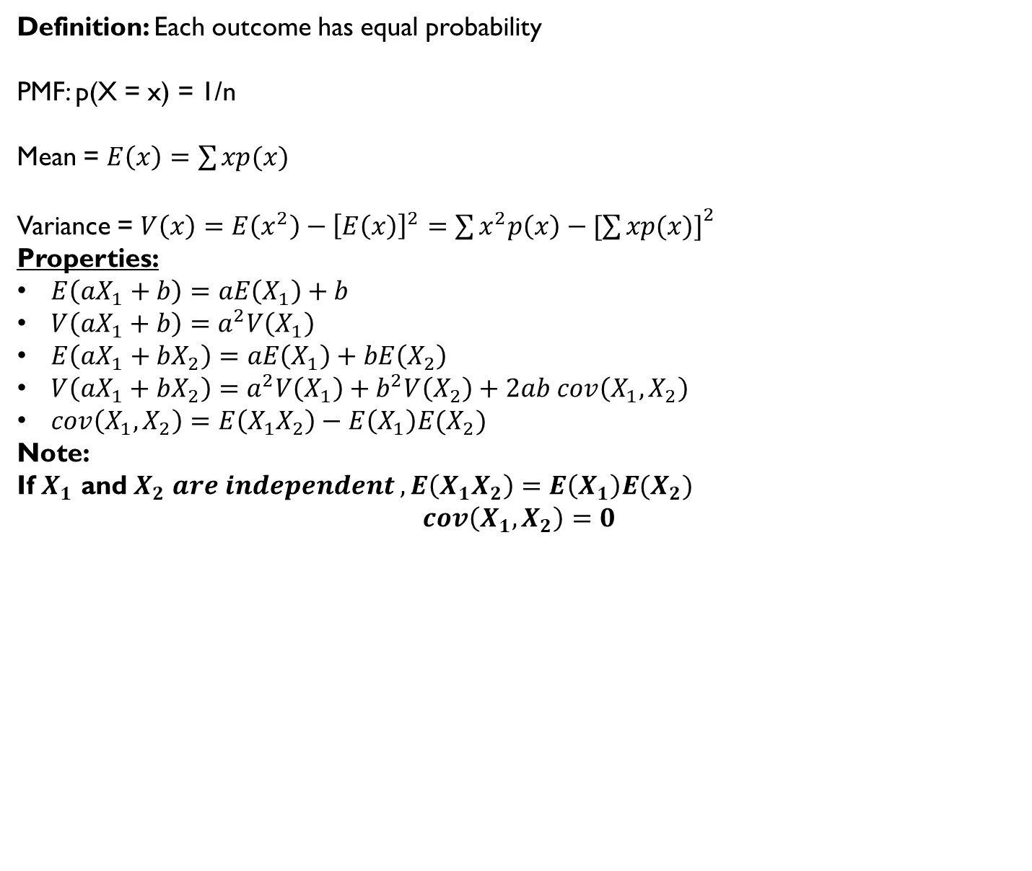
1. General Discrete Distribution
Definition: Each outcome has equal probability
PMF: p(X = x) = 1/n
Mean = $E\left(x\right)=\sum{xp(x)}$
Variance = $V\left(x\right)=E\left(x^{2}\right)−{\left[E\left(x\right)\right]}^{2}=\sum{x^{2}p\left(x\right)−[{\sum{xp(x)]}}^{2}}$
Properties:
$E\left(aX_{1}+b\right)=aE\left(X_{1}\right)+b$
$V\left(aX_{1}+b\right)=a^{2}V\left(X_{1}\right)$
$E\left(aX_{1}+bX_{2}\right)=aE\left(X_{1}\right)+bE\left(X_{2}\right)$
$V\left(aX_{1}+bX_{2}\right)=a^{2}V\left(X_{1}\right)+b^{2}V\left(X_{2}\right)+2ab cov\left(X_{1},X_{2}\right)$
$cov\left(X_{1},X_{2}\right)=E\left(X_{1}X_{2}\right)−E\left(X_{1}\right)E(X_{2})$
Note:
If $X_{1}$ and $X_{2} are independent , E\left(X_{1}X_{2}\right)=E\left(X_{1}\right)E(X_{2})$
$$cov\left(X_{1},X_{2}\right)=0$$

Slide 7
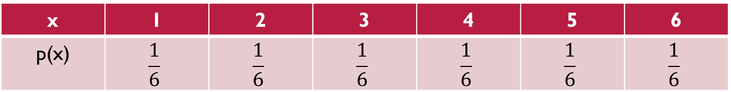

1. General Discrete Distribution
Example: Rolling a fair die (1 to 6)
p(X = x) = 1/n= 1/6
Mean = $E\left(x\right)=\sum{xp(x)}$= $1∗\frac{1}{6}+$ $2∗\frac{1}{6}+$ $3∗\frac{1}{6}+$ $4∗\frac{1}{6}+$ $5∗\frac{1}{6}+$ $6∗\frac{1}{6}=3.5$
Variance = $V\left(x\right)=E\left(x^{2}\right)−{\left[E\left(x\right)\right]}^{2}=\sum{x^{2}p\left(x\right)−[{\sum{xp(x)]}}^{2}=2.917}$
x | 1 | 2 | 3 | 4 | 5 | 6
p(x) | $$\frac{1}{6}$$ | $$\frac{1}{6}$$ | $$\frac{1}{6}$$ | $$\frac{1}{6}$$ | $$\frac{1}{6}$$ | $$\frac{1}{6}$$
P(X=1) = P(X=2) = P(X=3) = P(X=4) = P(X=5) = P(X=6) = 1/6

Slide 8
2. Bernoulli Distribution
Definition: One trial with two outcomes (success/failure)
PMF: P(X=1)= p, P(X=0)= 1-p
Example: Tossing a coin once (Head = 1, Tail = 0)
P(X=Head) = p = 1/2
P(X= Tail) = 1-p = 1-1/2 = 1/2

Slide 9
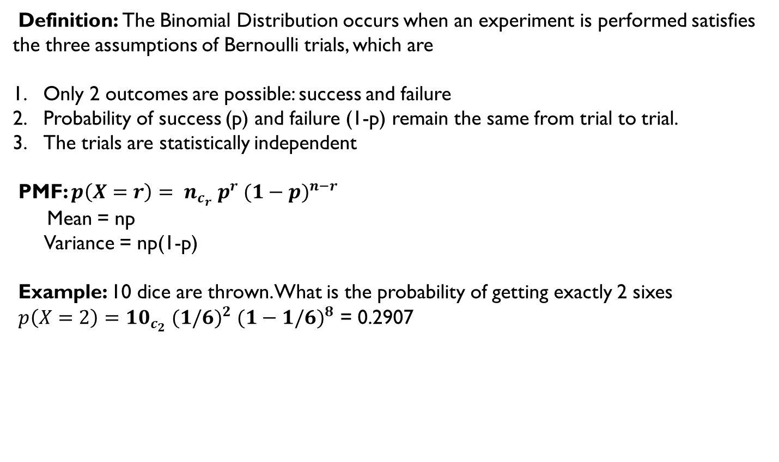
3. Binomial Distribution
Definition: The Binomial Distribution occurs when an experiment is performed satisfies the three assumptions of Bernoulli trials, which are
Only 2 outcomes are possible: success and failure
Probability of success (p) and failure (1-p) remain the same from trial to trial.
The trials are statistically independent
PMF: $p\left(X=r\right)= n_{c_{r}} p^{r} {(1−p)}^{n−r}$
Mean = np
Variance = np(1-p)
Example: 10 dice are thrown. What is the probability of getting exactly 2 sixes
$p\left(X=2\right)={10}_{c_{2}} {(1/6)}^{2} {(1−1/6)}^{8}$ = 0.2907

Slide 10
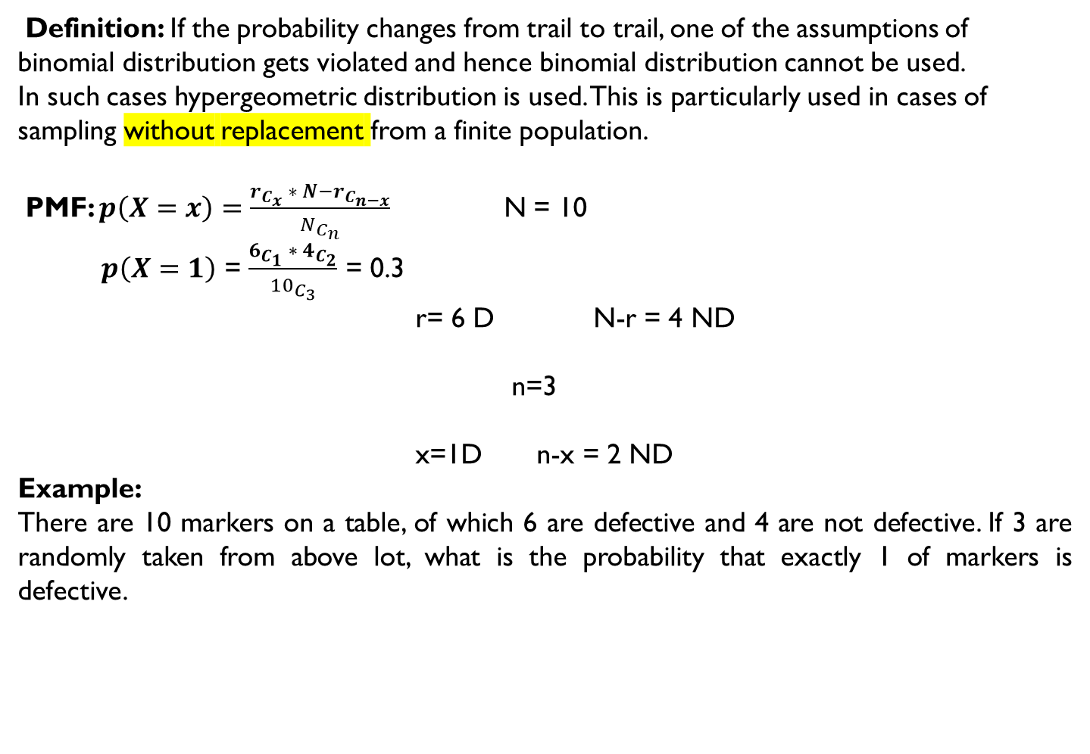
4. Hypergeometric Distribution
Definition: If the probability changes from trail to trail, one of the assumptions of binomial distribution gets violated and hence binomial distribution cannot be used.
In such cases hypergeometric distribution is used. This is particularly used in cases of sampling without replacement from a finite population.
PMF: $p\left(X=x\right)=$ $\frac{r_{C_{x}} ∗ {N−r}_{C_{n−x}}}{N_{C_{n}}}$ N = 10
$p\left(X=1\right)$ = $\frac{6_{C_{1}} ∗ 4_{C_{2}}}{{10}_{C_{3}}}$ = 0.3
r= 6 D N-r = 4 ND
n=3
x=1D n-x = 2 ND
Example:
There are 10 markers on a table, of which 6 are defective and 4 are not defective. If 3 are randomly taken from above lot, what is the probability that exactly 1 of markers is defective.

Slide 11
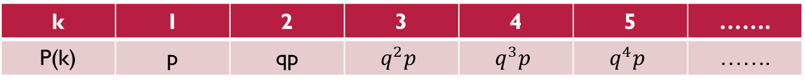
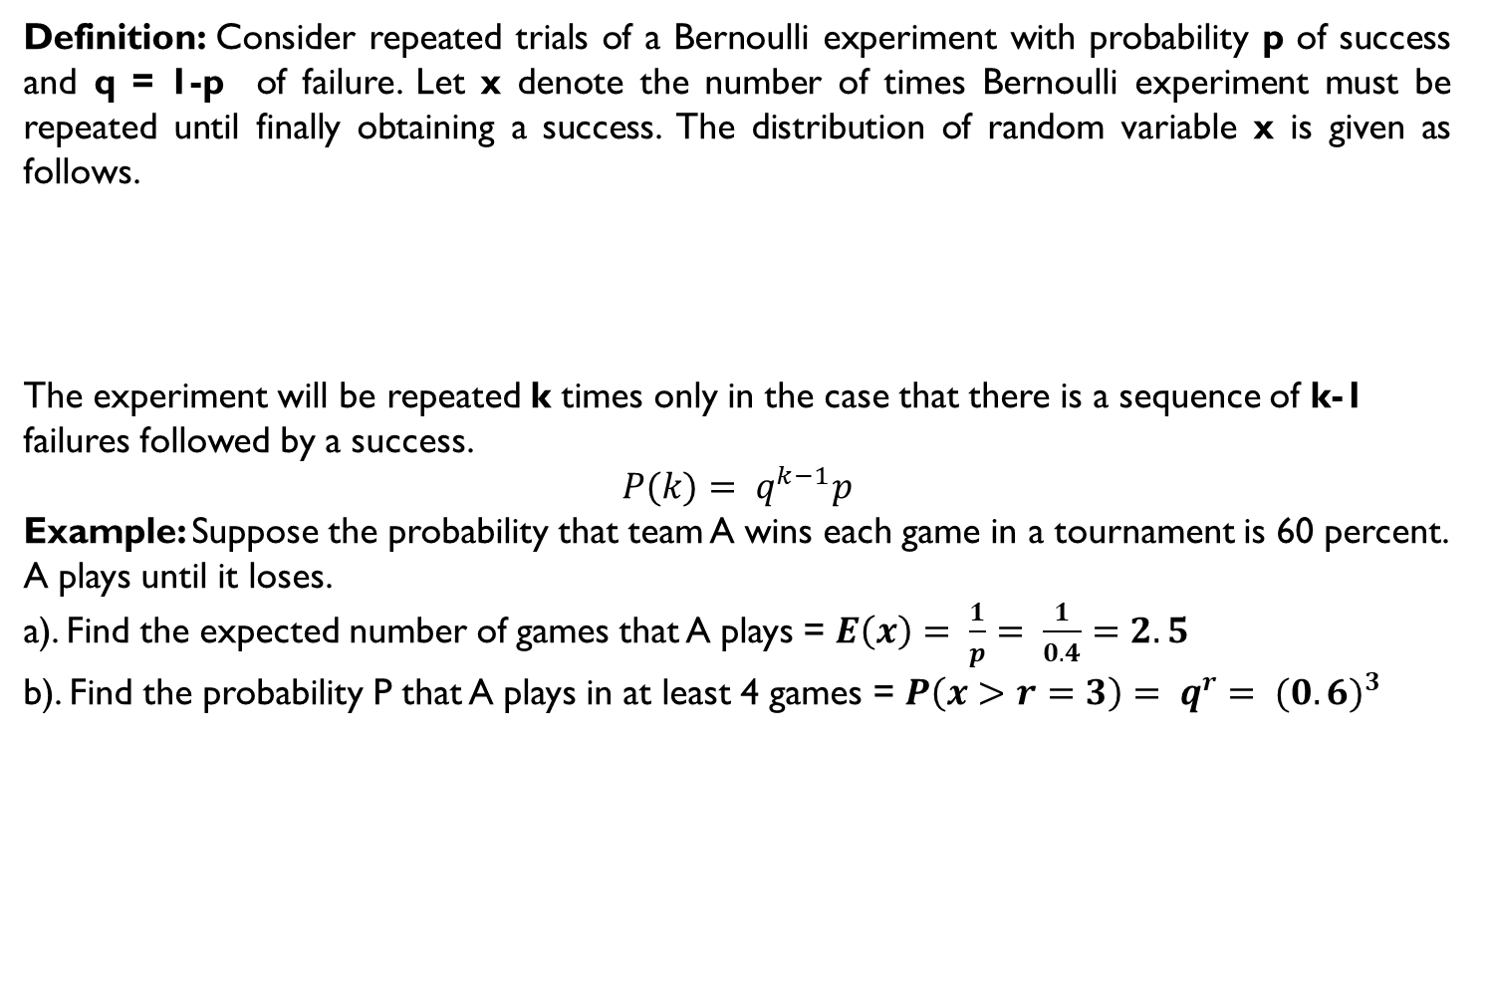
5. Geometric Distribution
Definition: Consider repeated trials of a Bernoulli experiment with probability p of success and q = 1-p of failure. Let x denote the number of times Bernoulli experiment must be repeated until finally obtaining a success. The distribution of random variable x is given as follows.
The experiment will be repeated k times only in the case that there is a sequence of k-1 failures followed by a success.
$$P(k)= q^{k−1}p$$
Example: Suppose the probability that team A wins each game in a tournament is 60 percent. A plays until it loses.
a). Find the expected number of games that A plays = $E\left(x\right)= \frac{1}{p}$ $= \frac{1}{0.4}=2.5$
b). Find the probability P that A plays in at least 4 games = $P\left(x>r=3\right)= q^{r}$ $= {(0.6)}^{3}$
k | 1 | 2 | 3 | 4 | 5 | …….
P(k) | p | qp | $$q^{2}p$$ | $$q^{3}p$$ | $$q^{4}p$$ | …….

Slide 12
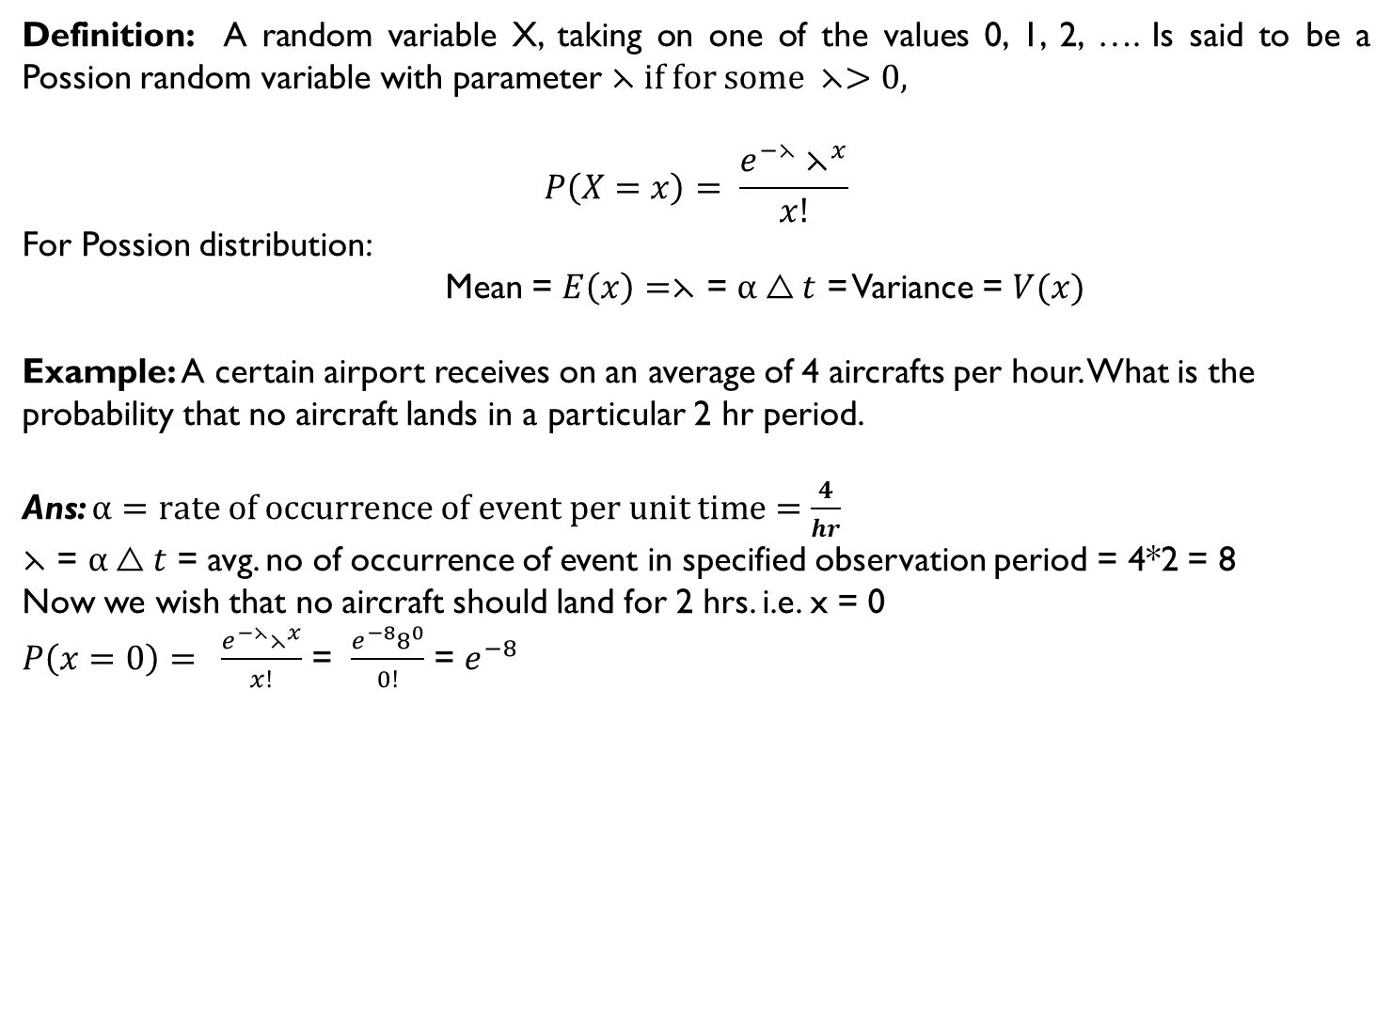
6. Poission Distribution
Definition: A random variable X, taking on one of the values 0, 1, 2, …. Is said to be a Possion random variable with parameter ⋋ if for some $⋋>0,$
$$P\left(X=x\right)= \frac{e^{−⋋}⋋^{x}}{x!}$$
For Possion distribution:
Mean = $E\left(x\right)=⋋$ = $α△t$ = Variance = $V(x)$
Example: A certain airport receives on an average of 4 aircrafts per hour. What is the probability that no aircraft lands in a particular 2 hr period.
Ans: $α=rate of occurrence of event per unit time=\frac{4}{hr}$
$⋋$ = $α△t$ = avg. no of occurrence of event in specified observation period = 4*2 = 8
Now we wish that no aircraft should land for 2 hrs. i.e. x = 0
$P\left(x=0\right)= \frac{e^{−⋋}⋋^{x}}{x!}$ = $\frac{e^{−8}8^{0}}{0!}$ = $e^{−8}$

Slide 13
Continuous Distributions
Types:
General Continuous Distribution
Uniform Distribution
Exponential Distribution
Normal Distribution
Standard Normal Distribution

Slide 14
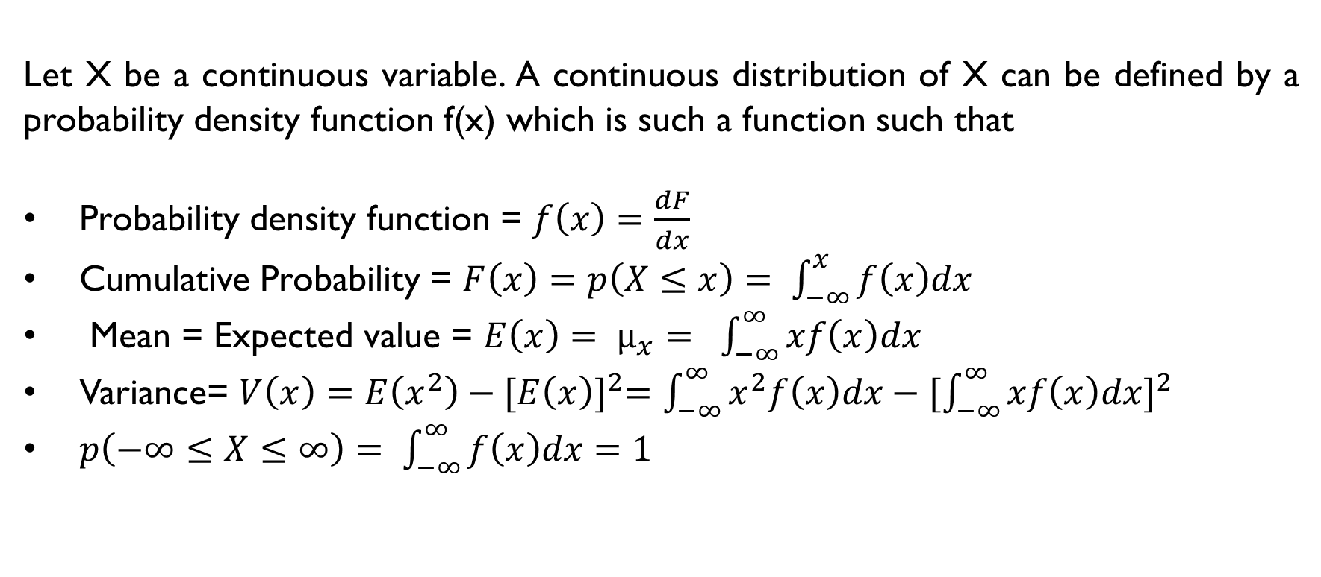
1. General Continuous Distributions
Let X be a continuous variable. A continuous distribution of X can be defined by a probability density function f(x) which is such a function such that
Probability density function = $f\left(x\right)=\frac{dF}{dx}$
Cumulative Probability = $F\left(x\right)=p\left(X≤x\right)= \int_{−∞}^{x}{f\left(x\right)dx}$
Mean = Expected value = $E\left(x\right)= µ_{x}= \int_{−∞}^{∞}{xf\left(x\right)dx}$
Variance= $V\left(x\right)=$ $E\left(x^{2}\right)−{[E\left(x\right)]}^{2}=$ $\int_{−∞}^{∞}{x^{2}f\left(x\right)dx}−{[\int_{−∞}^{∞}{xf\left(x\right)dx}]}^{2}$
$p\left(−∞≤X≤∞\right)= \int_{−∞}^{∞}{f\left(x\right)dx=1}$

Slide 15
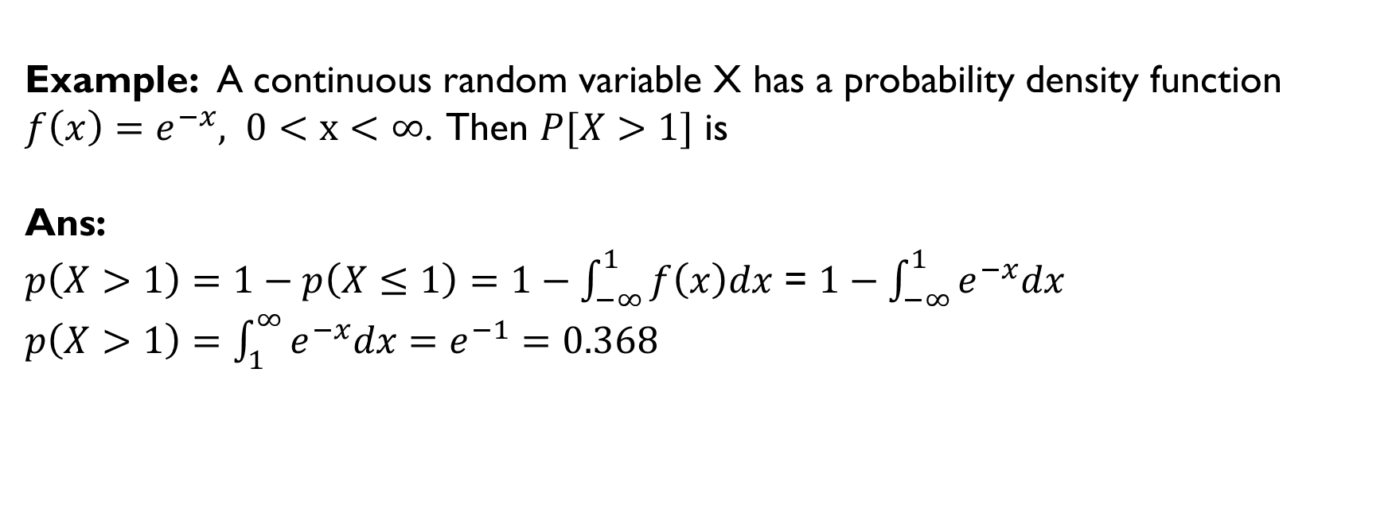
1. General Continuous Distributions (Cont…)
Example: A continuous random variable X has a probability density function
$f\left(x\right)=e^{−x}, 0<x<∞$. Then $P[X>1]$ is
Ans:
$p\left(X>1\right)=1−p\left(X≤1\right)=1−\int_{−∞}^{1}{f\left(x\right)dx}$ = $1−\int_{−∞}^{1}{e^{−x}dx}$
$p\left(X>1\right)=$ $\int_{1}^{∞}{e^{−x}dx}=e^{−1}=0.368$

Slide 16
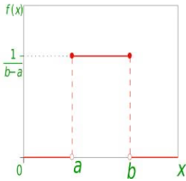
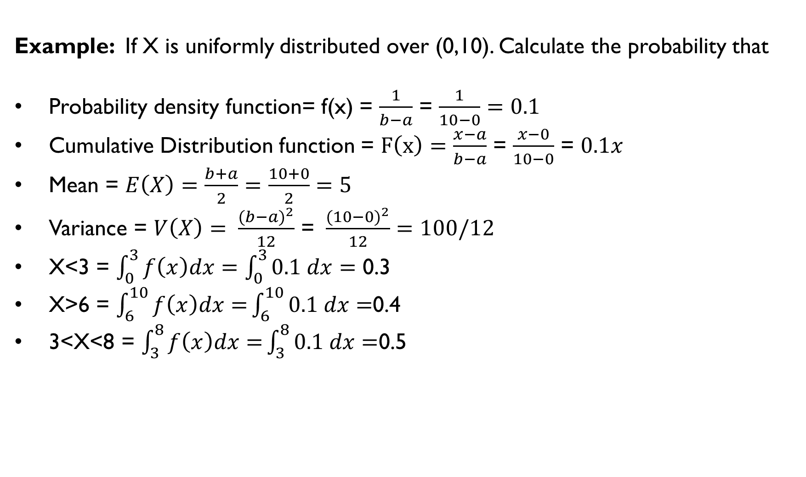
2. Uniform Distributions
Example: If X is uniformly distributed over (0,10). Calculate the probability that
Probability density function= f(x) = $\frac{1}{b−a}$ = $\frac{1}{10−0}=0.1$
Cumulative Distribution function = $F\left(x\right)=\frac{x−a}{b−a}$ = $\frac{x−0}{10−0}$ = $0.1x$
Mean = $E\left(X\right)=\frac{b+a}{2}$ $=\frac{10+0}{2}=5$
Variance = $V\left(X\right)= \frac{{(b−a)}^{2}}{12}$ = $\frac{{(10−0)}^{2}}{12}=100/12$
X<3 = $\int_{0}^{3}{f\left(x\right)dx=}$ $\int_{0}^{3}{0.1 dx=}$ 0.3
X>6 = $\int_{6}^{10}{f\left(x\right)dx=}\int_{6}^{10}{0.1 dx=}$0.4
3<X<8 = $\int_{3}^{8}{f\left(x\right)dx=}\int_{3}^{8}{0.1 dx=}$0.5

Slide 17
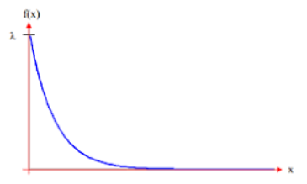

3. Exponential Distributions
Probability Density function = $f\left(x\right)=\left\{\begin{aligned}⋋e^{−⋋x}, if x≥0 \\ 0, if x<0\end{aligned}\right.$
Cumulative Distribution function = $F\left(a\right)=P\left(X≤a\right)=\int_{0}^{a}{⋋e^{−⋋x}dx={\left({−e}^{−⋋x}\right)}_{0}^{a}=1−}$ $e^{−⋋a}$, a$≥0$
Mean = $E\left[X\right]=\frac{1}{⋋}$
Variance = $V\left(X\right)= \frac{1}{⋋^{2}}$
Example: Suppose that the length of a phone call in minutes is an exponential random variable with parameter $⋋=0.1.$If someone arrives immediately ahead of you at a public telephone booth, find the probability that you will have to wait,
(a). More than 10 minutes = $P\left(X>10\right)=1−P\left(X≤10\right)=1−F\left(10\right)=1−(1−e^{−⋋10})$=0.368
(b). Between 10 and 20 minute = $P\left(10<X<20\right)=F\left(20\right)−F\left(10\right)=0.233$

Slide 18
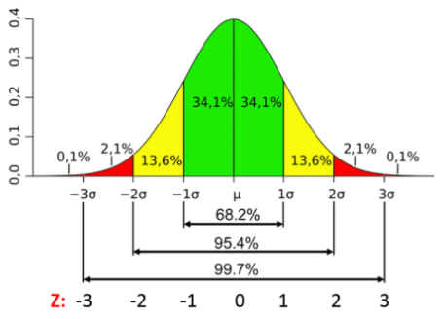
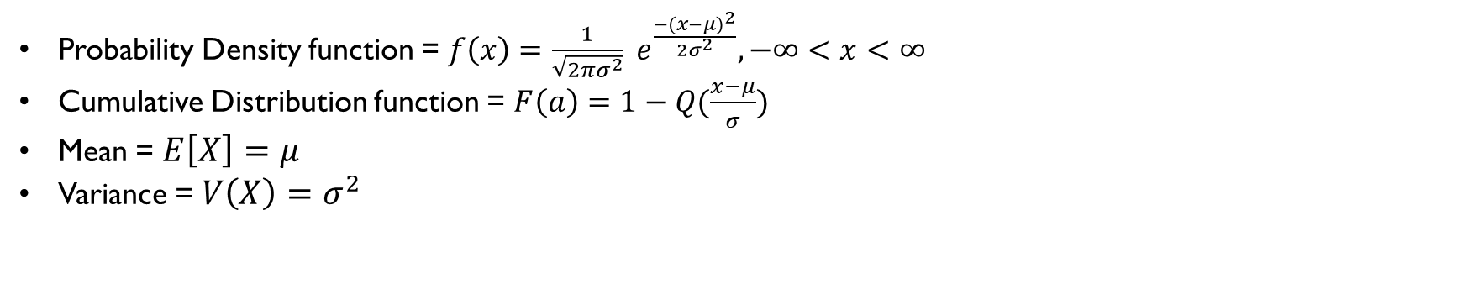

4. Normal Distributions $[N(μ,σ^{2})]$
Probability Density function = $f\left(x\right)=$ $\frac{1}{\sqrt{2πσ^{2}}} e^{\frac{−{(x−μ)}^{2}}{2σ^{2}}}, −∞<x<∞$
Cumulative Distribution function = $F\left(a\right)=1−Q(\frac{x−μ}{σ})$
Mean = $E\left[X\right]=$ $μ$
Variance = $V\left(X\right)=σ^{2}$

Slide 19
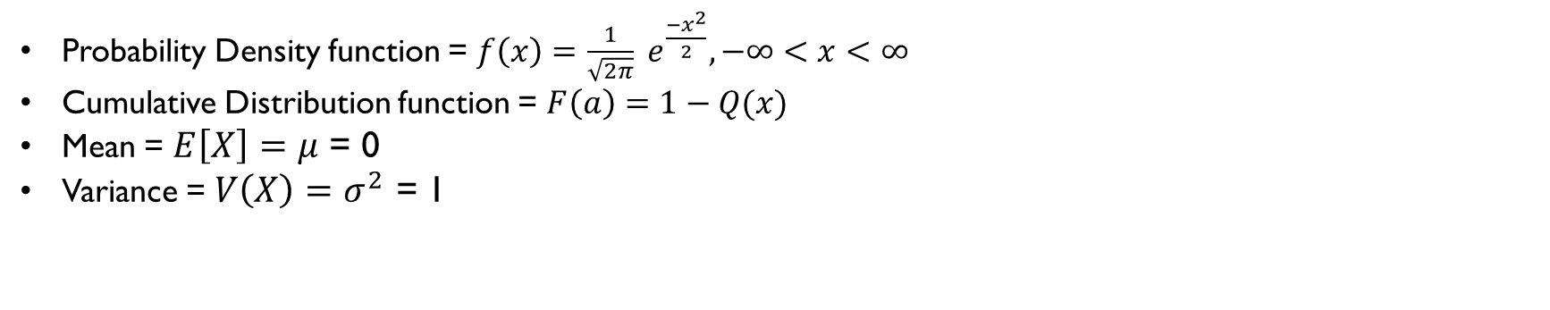

5. Standard Normal Distributions $[N(0,1)]$
Probability Density function = $f\left(x\right)=$ $\frac{1}{\sqrt{2π}} e^{\frac{−x^{2}}{2}}, −∞<x<∞$
Cumulative Distribution function = $F\left(a\right)=1−Q(x)$
Mean = $E\left[X\right]=$ $μ$ = 0
Variance = $V\left(X\right)=σ^{2}$ = 1

Slide 20
Applications
Finance:
Discrete distributions are used for event counts like defaults, while continuous distributions model returns or risk (e.g., normal distribution for asset returns).
Healthcare:
Discrete: Number of new disease cases. Continuous: Time until recovery or length of hospital stay.
Survey Analysis:
Discrete: Multiple-choice responses (e.g., “yes”, “no”, “maybe”). Continuous: Data like income, age, measured on a scale.
Engineering:
Discrete: Counting number of product failures. Continuous: Measuring surface finish quality or tensile strength of materials.
Marketing: Discrete: Purchases per customer. Continuous: Time spent viewing a product page

Slide 21

Expectation
Expectation (or expected value) in probability and statistics refers to the long-run average outcome of a random variable over many repetitions of an experiment. It tells us what value we "expect" to see on average.
For a discrete random variable X, the expectation is calculated by multiplying each possible value by its probability and summing these products:
For a continuous random variable, we integrate over all possible values

Slide 22
Expectation
Example:
Rolling a Fair 6-Sided Die
Each face (1–6) has a probability of 1/6.
Expectation calculation:
So, the expected value from rolling a fair die is 3.5. If you roll the die a very large number of times, the average result will approach 3.5.
Summary:
Expectation provides a powerful way to predict average outcomes, guiding decisions in contexts from finance to games, insurance, science, and everyday situations.

Slide 23

Expectation- Continuous
The expectation (expected value) of a continuous random variable is calculated using integration rather than summation.
If X is a continuous random variable with probability density function (pdf) f(x), then its expectation is:
This formula works just like the discrete case, but instead of adding up the products of values and probabilities, you integrate the product of each possible value and its density over the entire range of X.

Slide 24
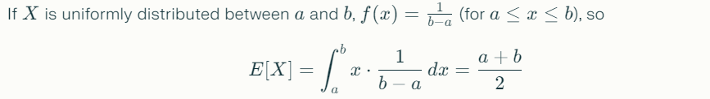
Expectation- Continuous
Example:
The expectation (expected value) of a continuous random variable is calculated using integration rather than summation.
In practical terms, expectation tells us the average value of the random variable if the process is repeated many times.

Slide 25
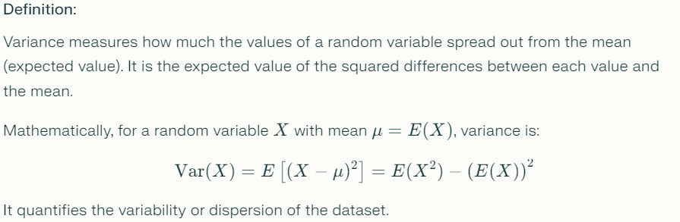
Variance

Slide 26

Variance
Example:
Consider rolling a fair six-sided die. The mean μ=3.5μ=3.5. The variance is calculated as:
This shows how the results fluctuate around the average value 3.5

Slide 27
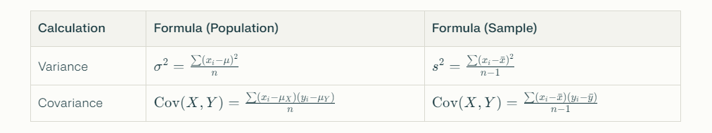
Calculation of Variance and Covariance

Slide 28
Covariance
Covariance measures how two random variables vary together. It indicates whether increases in one variable tend to be accompanied by increases or decreases in the other.
For two random variables X and Y with means E(X) and E(Y),
covariance is:
Positive covariance means the variables tend to increase or decrease together.
Negative covariance means when one increases, the other tends to decrease.
Zero covariance means no linear relationship.

Slide 29
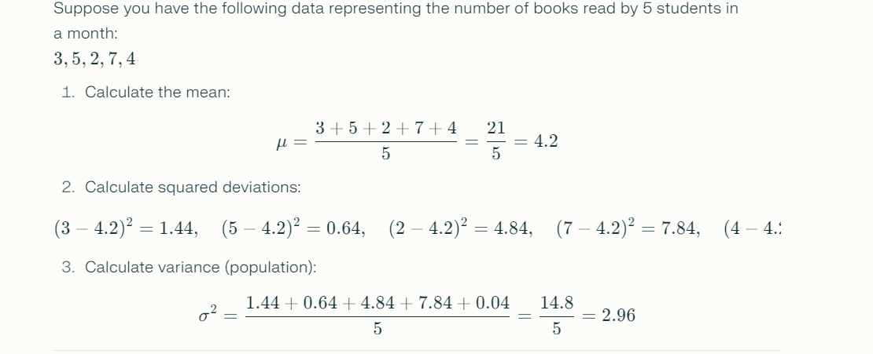
Example of Variance

Slide 30
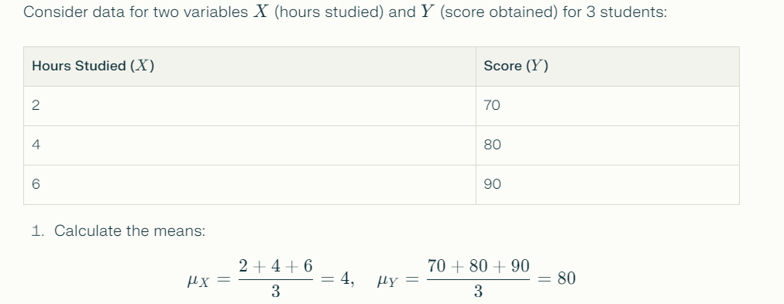
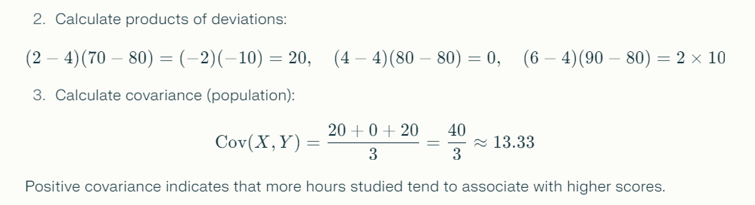
Example of Covariance

Slide 31
Reference Books:
1. Russel and Norvig, ‘Artificial Intelligence’, third edition, Pearson Education, PHI, (2015)
2. Elaine Rich & Kevin Knight, ‘Artificial Intelligence’, 3nd Edition, Tata Mc Graw Hill Edition, Reprint( 2008)
Sites and Web links:
https://www.virtusa.com/digital-themes/heuristic-search-techniques
https://towardsdatascience.com/a-star-a-search-algorithm-eb495fb156bb
https://www.tutorialandexample.com/local-search-algorithms-and-optimization-problem/
http://cgi.di.uoa.gr/~ys02/siteAI2008/local-search-2spp.pdf
http://aima.eecs.berkeley.edu/slides-pdf/chapter04b.pdf

